Slide 1


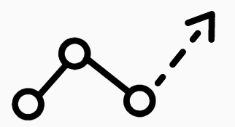
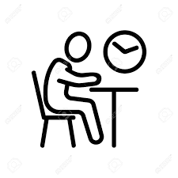


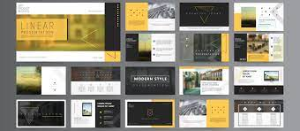


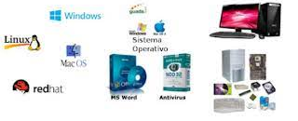






App Developer
Web Developer
Video Editor
Graphics Designer
Marketing
Game development
Media and Communications Co-Ordinator
Digital Designer
Visual Designer
VFX artist
Multimedia programmer
Interactive Media
A level or vocational courses
Apprenticeships
2022 Y11 Exam
Reset
MOCK WRITTEN
EXAM #3
WRITTEN
EXAM
1 x written exam
1 hour 30 minutes
Exam skills, revision
Booster sessions
6. Promotion and presentation of interactive media products
2022 Y11 Unit 4
MOCK WRITTEN
EXAM #1
MOCK WRITTEN
EXAM #2
Independent Synoptic Project:
17 hours
5. Developing an interactive media product
YEAR
11
3. Software and hardware options for interactive media products
7. Review of production processes and final product
2022 Y11 Unit 3
4. Product proposals and planning for interactive media products
2. Features of interactive media products
1. Types of interactive media products in context
YEAR
10
Python programming: expanding on year 8s introduction using iteration
Independent development of portfolio expanding the portfolio on topics of personal interest
Developing a portfolio: graphic design and setting up for the whole year
Photoshop: creating a magazine cover
Cyber security: The dangers to technology and how to reduce the risks
Developing a Computer systems video
Data representation and creation of Images and sound
YEAR
9
Computer systems: Hardware and software and connectivity between devices
Web design: creating a basic navigable website and all the assets needed.
Introduction to programming with python: inputs, outputs, processing and selection
YEAR
Data representation: Binary and Hexadecimal maths
8
Introduction to algorithms and developing a game in scratch
How to use school systems: Logging on, email, Go 4 Schools, paper cut printing, century tech, saving and accessing files, basic formatting of documents
YEAR
7
Creating documentation
to show safe use of technology

