Slide 1


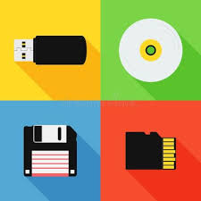


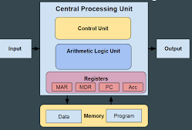

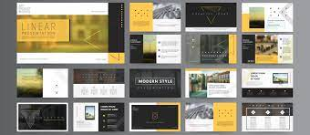


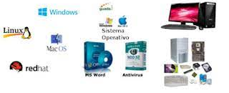






Computer Programmer
Hardware Engineer
Software Developer
Systems Manager
Web Developer
Software Engineer
Database Administrator
IT Architect
Network Administrators
Systems Analysts
Security Analysts
Computer Science
Computer science
A Level
Further study
2x GCSE Computer Science EXAMS
Exam skills, revision
Booster sessions
MOCK
EXAMS 3
Ethical, legal, cultural and environmental impacts of digital technology
Revision based on Mock exam 2
Memory and storage
Software
MOCK
EXAMS 1
YEAR
MOCK
EXAMS 2
11
Network and network security
OCR GCSE Computer science
Systems architecture
Producing robust programs
Programming fundamentals
Algorithms, decomposition, abstraction
YEAR
10
Python programming: expanding on year 8s introduction using iteration
Independent development of portfolio expanding the portfolio on topics of personal interest
Developing a portfolio: graphic design and setting up for the whole year
Photoshop: creating a magazine cover
Cyber security: The dangers to technology and how to reduce the risks
Developing a Computer systems video
Data representation and creation of Images and sound
YEAR
9
Computer systems: Hardware and software and connectivity between devices
Web design: creating a basic navigable website and all the assets needed.
Introduction to programming with python: inputs, outputs, processing and selection
YEAR
Data representation: Binary and Hexadecimal maths
8
Introduction to algorithms and developing a game in scratch
How to use school systems: Logging on, email, Go 4 Schools, paper cut printing, century tech, saving and accessing files, basic formatting of documents
YEAR
7
Creating documentation
to show Safe use of technology

