Slide 1






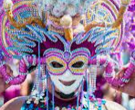


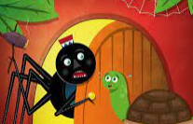






Move onwards
to great things!
French
A Level French
Further study
GCSE speaking exam
AQA GCSE unit 8 plans for the future
3 X GCSE
EXAMS
Exam skills, revision
Booster sessions
MOCK
EXAMS 3
AQA GCSE unit 5 Holidays
AQA GCSE Our planet
AQA GCSE unit 4 Healthy lifestyles
AQA GCSE unit 7 The world and I!
YEAR
11
MOCK
EXAMS 2
AQA GCSE unit 3 Life at school
AQA GCSE unit 2. Freetime
MOCK
EXAMS #1
YEAR
AQA GCSE unit 1 Family and relationships
10
Hobbies and freetime
Future plans and world of work
Literary text
The world around us
Festivals and celebrations
Holidays
YEAR
9
Literary text –
Poem by Jacques Prévert
Free time and hobbies
Literary text
”Anansi et Tortue”
Family life
In town
YEAR
8
Phonics and introductions
YEAR
7
Life at school
A visit to “Café Citron”

