Slide 1


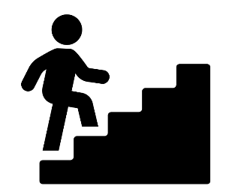








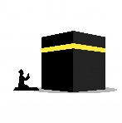

Move onwards
to great things!
Religious Studies
RS
Philosophy
Politics
A Level
Muslim attitudes to peace and conflict
Further study
3x GCSE
RS EXAMS
Exam skills, revision
Booster sessions
MOCK
EXAMS 3
Living the Muslim Life
Living the Muslim life
Matters of Life and Death
YEAR
MOCK
EXAMS 2
MOCK
EXAMS #1
11
Muslim attitudes to crime and punishment
Muslim beliefs
Living a Christian life
YEAR
10
How do we know what is right or wrong? (Philosophy)
Christian marriage and the family
Does God exist? (Philosophy)
Christian beliefs
How does Christianity address modern challenges? (Theology)
How do we know what is real? (Philosophy)
What is religion and is it dying? (Social sciences0
How do humans express their spirituality? (Philosophy)
YEAR
9
What does it mean to be a Sikh in Britain today? (Theology)
How might a person’s beliefs cause them to challenge authority? (Social sciences)
Does Buddhist Dharma provide answers for why we suffer? (Philosophy)
Who are the ‘Nones’?
(Social Sciences)
Why is Christianity the way it is? (Theology)
YEAR
8
Is it possible to follow Prophet Muhammad’s teachings in 21st century Britain? (Theology)
How do different worldviews perceive Jesus? (Theology)
What is a worldview? (Social sciences)
YEAR
7
How are the Abrahamic faiths connected through the Prophets?
(Theology)

