Slide 1





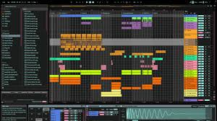




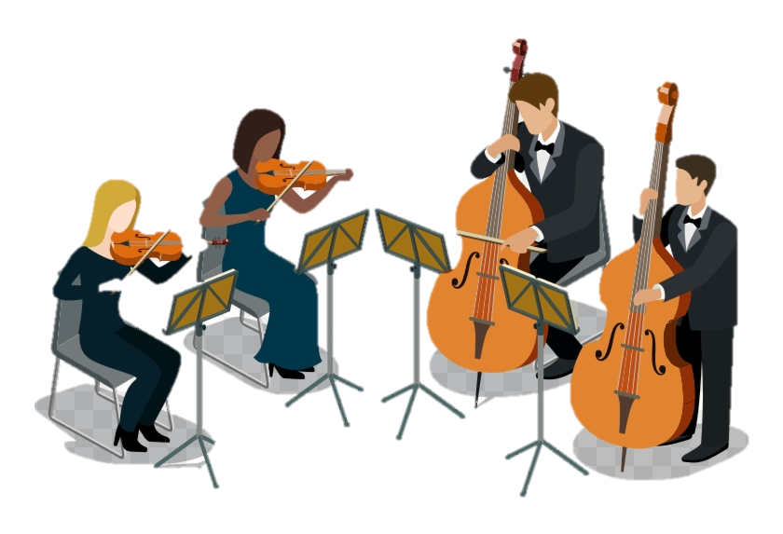

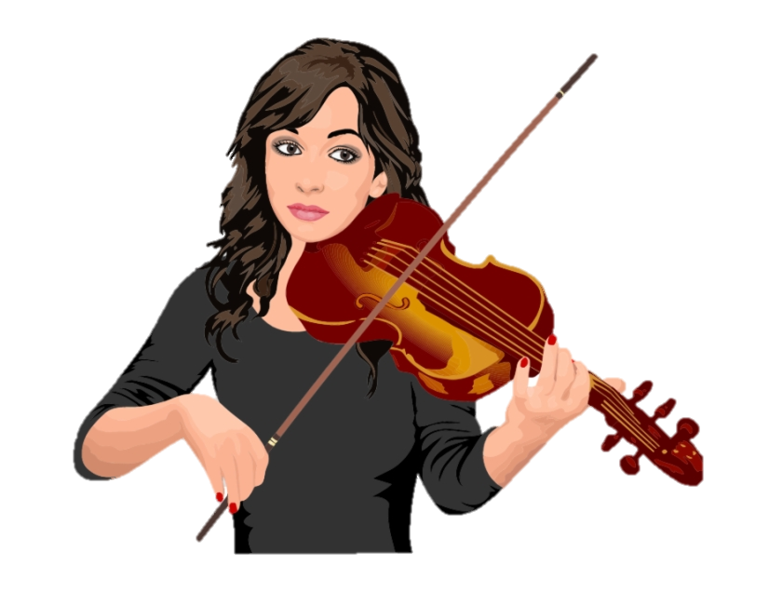







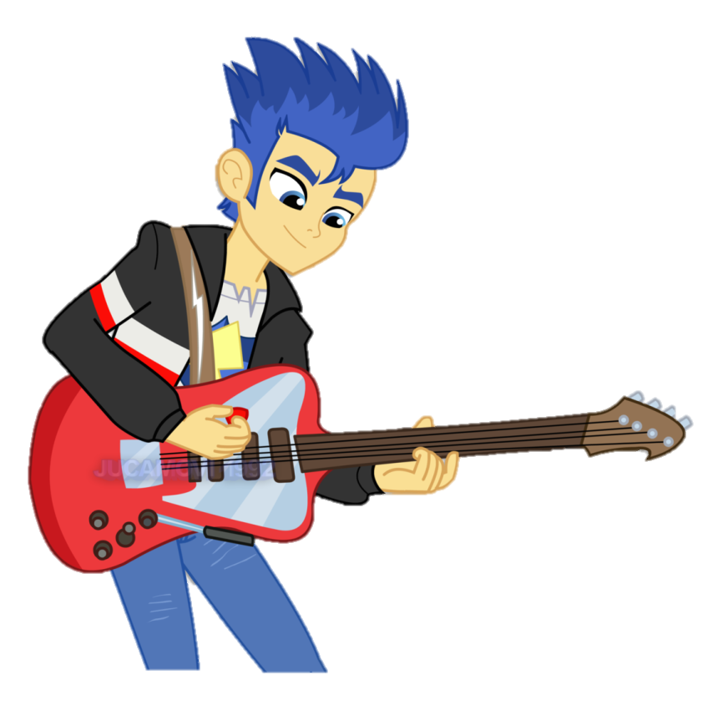
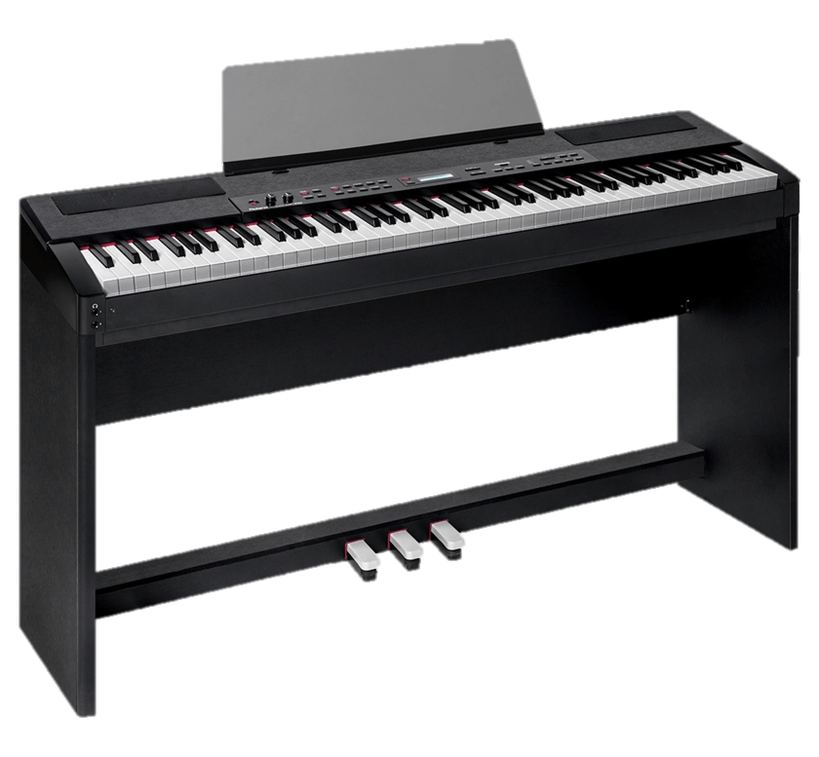
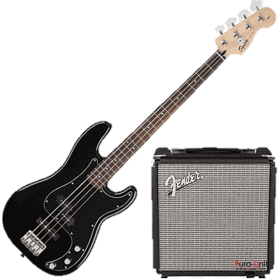


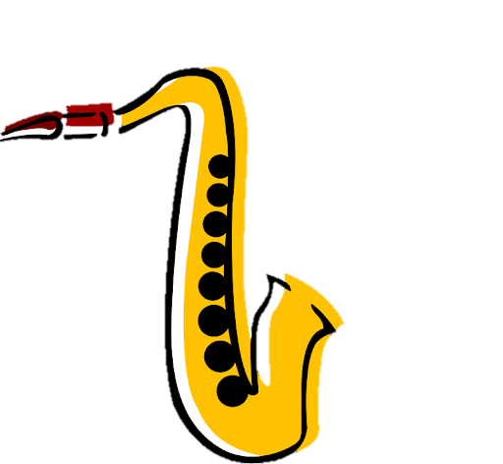


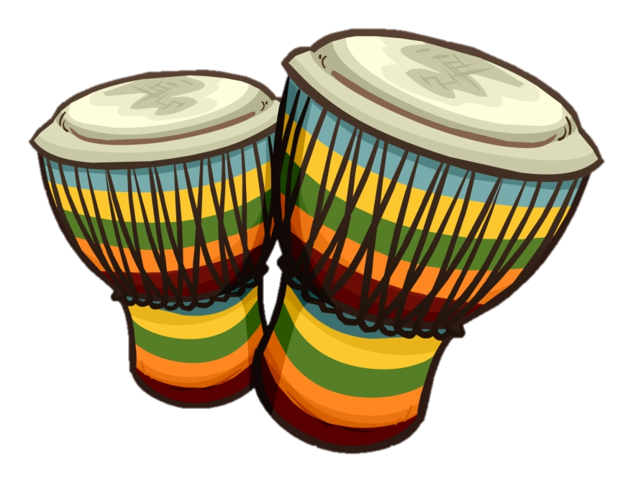

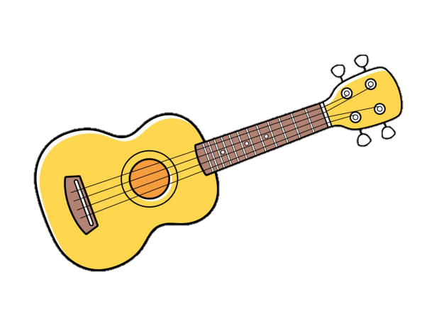







LBA Music
Learning Journey
Higher Education
BTEC Music - Component 3
Mock
Final coursework submission
Apprenticeships
BTEC Music - Component 1
BTEC Music - Component 2
11
BTEC Music - Component 2
  Performance to a Brief
Horror in Music
10
Ableton - Foundation Skills
Electric Dance Music
Composing to a Brief
Music in Gaming
Reggae
Programme Music
Minimalism
9
Music for Media
Dick Whittington
Pantomime trip for year 7
Advanced Rhythms of the World
Composing to a Brief
8
Structure in Music
Hooks and Riffs
Blues Music
Advanced Notation - Composition
7
Rhythms of the World
Instruments of the Orchestra
Singing -
Elements of Music

