Slide 1

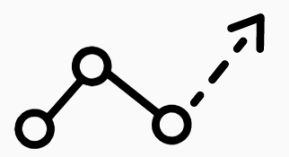
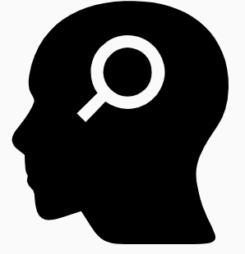
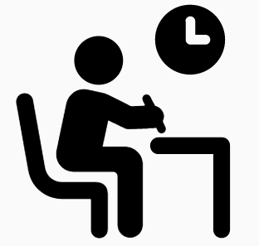

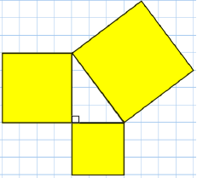
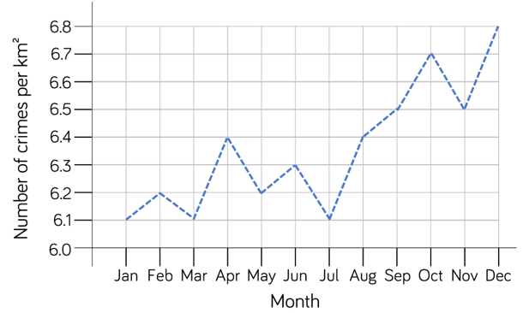
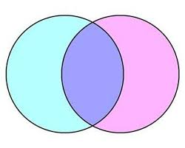
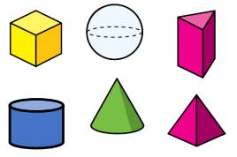
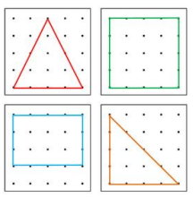


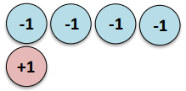

Move onwards
to great things!
Mathematics 2025/2026
A Level Mathematics
Core Maths
3x GCSE
EXAMS AQA
Exam skills, revision
Booster sessions
MOCK
EXAMS 3
H: Further Graphs and Estimation
F: Revision
Primes, factors and multiples
Sequences
Indices and Surds
H: Further Geometry
F: Revision
Averages and range
Representing data
YEAR
MOCK
EXAMS 2
MOCK
EXAMS 1
11
Circles
Simultaneous equations
Quadratics
Similarity and Enlargement
Trigonometry
H: Further Algebra
F:Revision
Probability and combinations
YEAR
10
Managing money
Percentages
Proportional reasoning
Relative frequency
Tree diagrams
Venn diagrams
2D representations of 3D shapes
Surface area and volume
Angles and bearings
Rotation and translation
Similar shapes
Surds
Pythagoras Theorem
Graphs and algebra
Speed, distance, time
The data handling cycle
Measures of location
Multiplying and dividing fractions
Fractions and percentages
YEAR
9
Brackets
Equations
Inequalities
Sequences
Indices
Angles in polygons
Area and circumference of circles
Symmetry and reflection
Sets and probability
Prime numbers and proof
Ratio
Multiplicative change
YEAR
Constructing and measuring
Developing geometric reasoning
8
The Cartesian plane
Representing data
Tables and probability
Addition and subtraction
Multiplication and division
Sequences
Algebraic notation
Equality and equivalence
YEAR
7
Directed number
Fractional thinking
Place value and ordering
FDP equivalents

