Slide 1


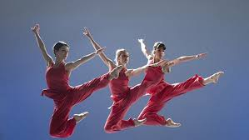
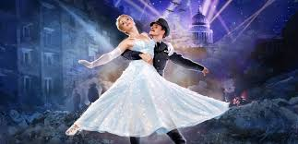
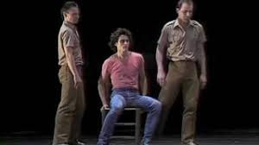




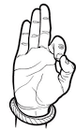

Performing Arts
A Level
Component Three
Responding to a brief.
Students research, devise and perform their own piece of theatre in response to an exam board brief. They are also assessed on their Ideas, skills development and evaluation logs.
Further study/Life Skills
Move onwards
to great things!
Component 2. Developing Skills and Techniques:
Dance workshops, Performance skills ,technical skills.
Choice of performance style, grouping, repertoire.
Students are assessed throughout the rehearsal process, their final performance and also through their written their dancer's logbook
Submission of Component 3
MOCK
EXAM C3
YEAR
11
Submission of Component 2
Dance technique workshops focusing on key skills needed for component 2
Component 2. Developing Skills and Techniques:
Dance workshops, Performance skills ,technical skills.
Choice of performance style, grouping, repertoire.
Students are assessed throughout the rehearsal process, their final performance and also through their written their dancer's logbook.
YEAR
Submission of Component 1
10
Component One. Exploring the Performing Arts: Students learn about the key practitioners in theatre making study the first two pieces of professional repertoire. Students then study a further play text from contrasting style. Students are assessed on their understanding of the page to stage process of theatre creation.
Opportunities for performances and extra curricular
YEAR
9
Twilight
Carnival
Street Dance
Martial Arts
YEAR
Disco
8
Physical Skills in Dance
Trinity College Arts Award Bronze
Expressive Skills in Dance
Motif Variation
YEAR
7
Indian Dance
Technical Skills in Dance
Lion King

