Slide 1

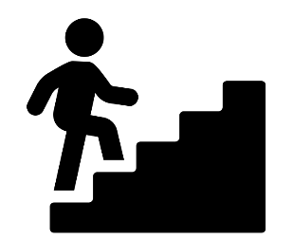
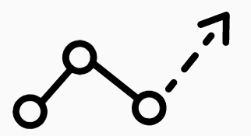
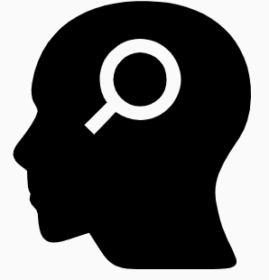
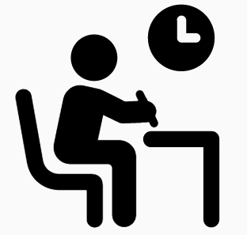

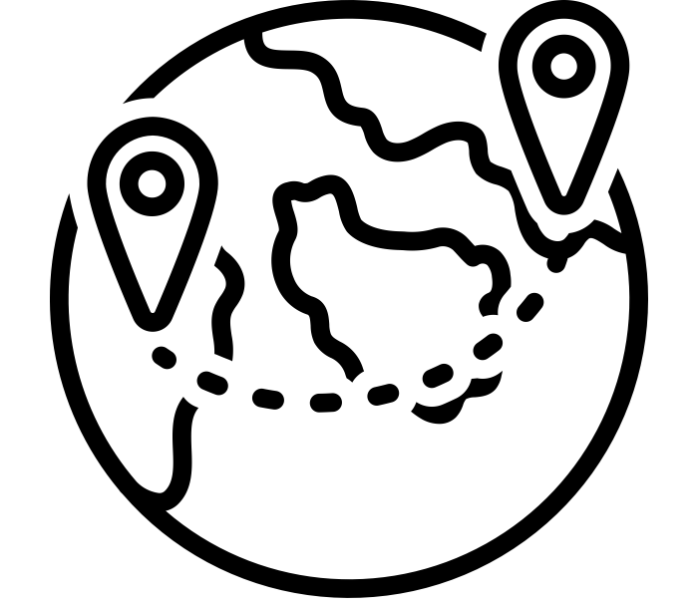

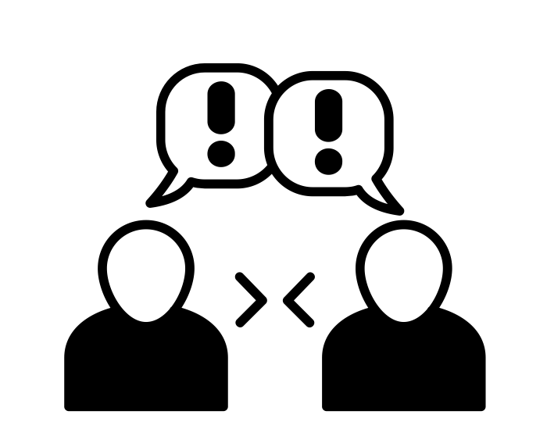
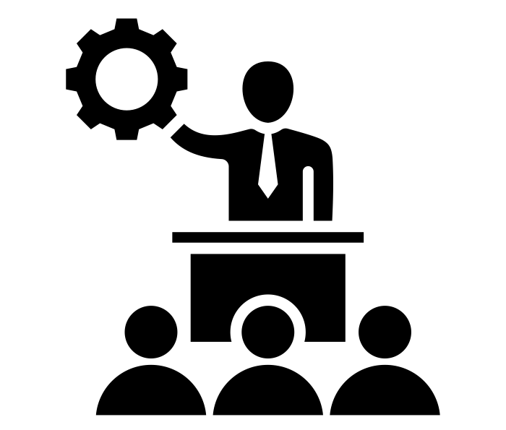
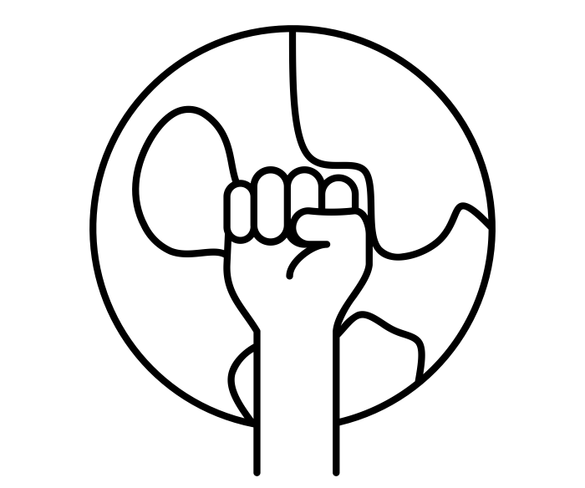










Move onwards
to great things!
HISTORY
History
A Level
Life in Elizabethan England
Including Historic environment
Further study
2x GCSE
RE EXAMS
MOCK
EXAMS 3
Exam skills, revision
Booster sessions
Migration, Empires and People – Looking West
Migration, Empires and People – Expansion and Empire
Elizabethan England: Troubles at Home and Abroad
Migration, Empires and People – Conquered and conquerors
MOCK
EXAMS 1
YEAR
MOCK
EXAMS 2
Elizabethan England: Government
11
Germany, Democracy to Dictatorship: Life under the Nazis
Germany, Democracy to Dictatorship: Weimar Germany
Conflict and Tension: Ending the First World War
Migration, Empires and People – Britain in the 20th century
YEAR
10
Germany, Democracy to Dictatorship: Rise of the Nazis
Conflict and Tension: Weapons and Tactics in the First World War
How much did the civil rights movement of the 20th century achieve?
Conflict and Tension: Causes of the First World War
A changing world: Terrorism
What do sources tell us about tensions during the Cold War?
What was the turning point of WWII?
Should the ‘forgotten’ be written into a school’s History of the First World War?
How close did Britain come to true democracy?
What do sources reveal about the nature of the Holocaust?
YEAR
9
How far were Obas the driving force behind Benin’s rise?
Did everyone benefit from the industrial revolution?
Were the Mughals the Indian Tudors?
YEAR
8
How did slavery develop and decline in the British Empire?
What did it mean to be English in the 17th century?
How have invasions changed England?
YEAR
7
What do sources reveal about Medieval life?
Did the Normans bring a ‘truckload of trouble’?

