Slide 1
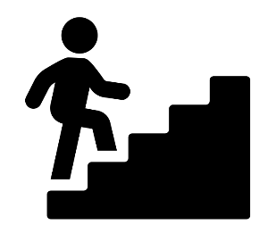
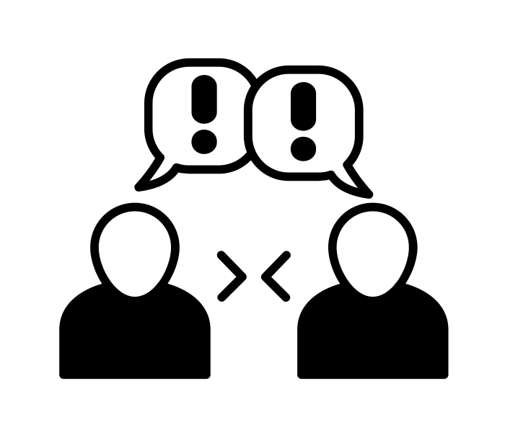
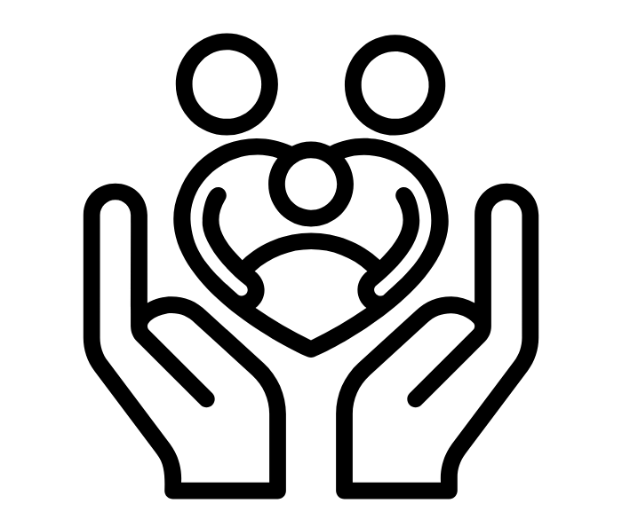
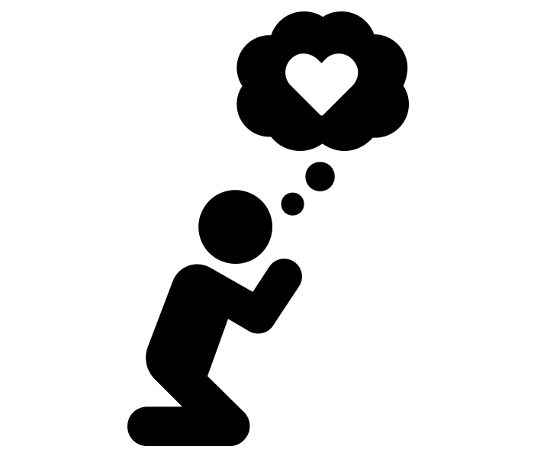
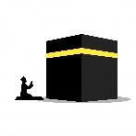
Move onwards
to great things!
Religious Studies
RS
Philosophy
Politics
A Level
Further study
3x GCSE
RS EXAMS
Exam skills, revision
Booster sessions
MOCK
EXAMS 3
Muslim attitudes to peace and conflict
Living the Christian life
Living the Muslim life
YEAR
MOCK
EXAMS 2
MOCK
EXAMS #1
11
Christian marriage and the family
Christian matters of life and death
Muslim attitudes to crime and punishment
YEAR
10
Muslim beliefs
Should happiness in this life be the ultimate goal?
How do you know if something is right or wrong?
Christian beliefs
Religion and Power
Do Christians offer solutions to arguments against God?
World Views
Spiritual Arts
YEAR
9
What does justice mean to Christians?
World Views
Sikhism in Britain today
People of faith
Do the 10 Commandments still apply?
YEAR
8
Is it possible to follow Prophet Muhammad’s teachings in 21st century Britain?
What was so radical about Jesus?
Do Christian beliefs impact how a Christian lives their life?
YEAR
7
What does it mean to be ‘chosen’ by God?

