Slide 1










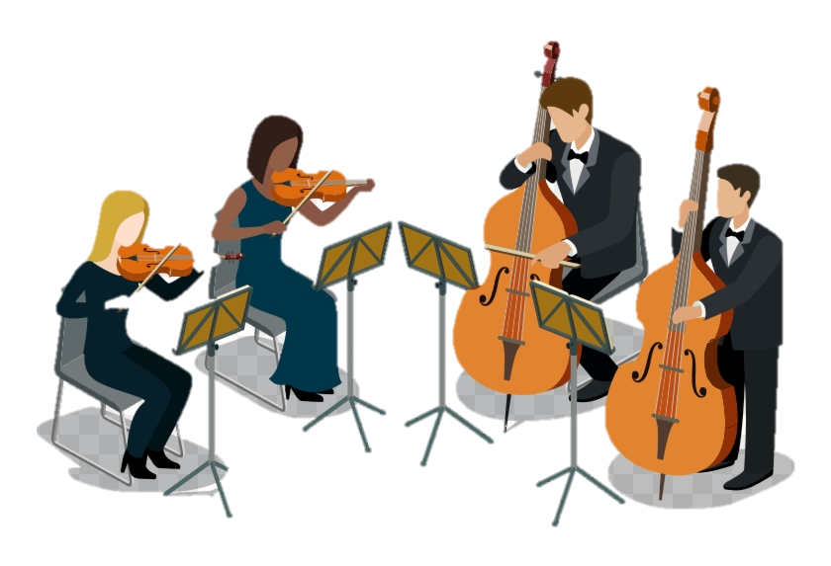




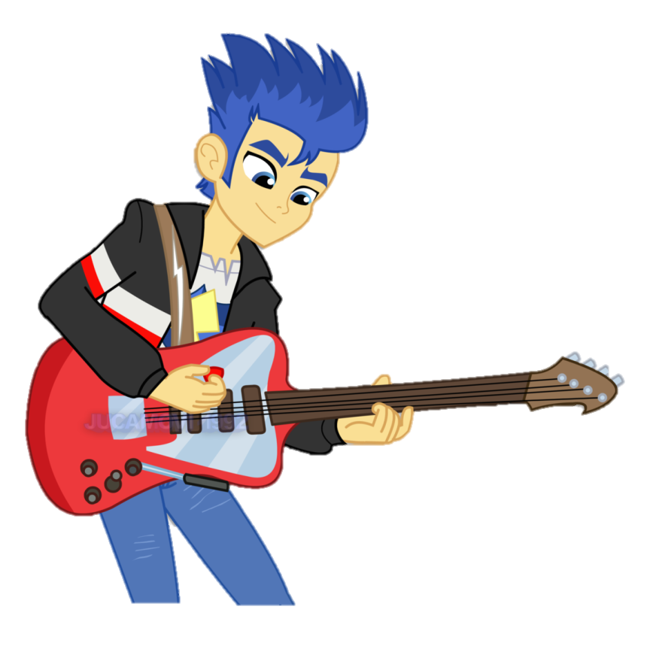


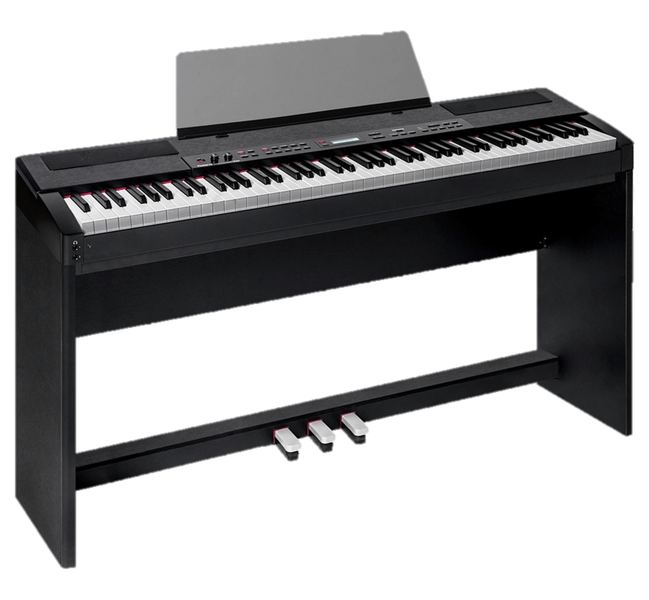
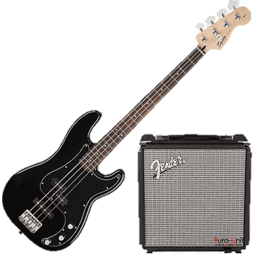


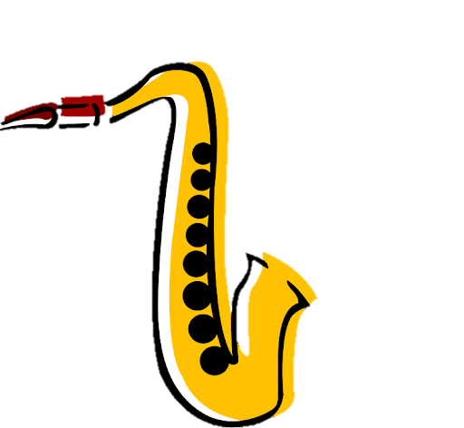





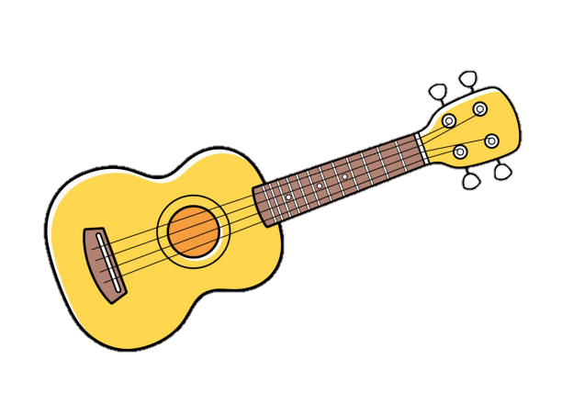







LBA Music
Learning Journey
Higher Education
Area of Study 2 - Music for Ensemble
Area of Study 3 - Film Music
Performance and composition coursework clinic and submission
Area of Study 4 Popular Music
Listening & Appraising practice
Area of Study 1 -Musical Forms and Devices
Apprenticeships
Set Brief Composition clinic
Area of Study 4 - Popular Music
Area of Study 3 - Film Music
Area of Study 2 - Music for Ensemble
Area of Study 1 - Set work
Ensemble Performance recording
11
Solo Performance recording
Free Brief Composition clinic
Area of Study 4 Popular Music
  Reggae Music
Horror in Music
10
Elements of Music - Foundation Skills
Music Production 2
Electric Dance Music
GCSE Set work 1
Toto Africa
Indian Classical music and Bhangra
composition and performance
Programme Music
Minimalism
9
Music for Media
Chitty Chitty Bang Bang Musical Theatre trip
Cinderella
Pantomime trip for year 7
Advanced Rhythms of the World
Composing to a Brief
8
Structure in Music
Hooks and Riffs
Blues Music
Advanced Notation - Composition
7
Rhythms of the World
Instruments of the Orchestra
Singing -
Elements of Music

