Slide 1
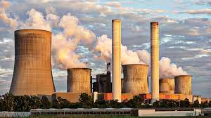
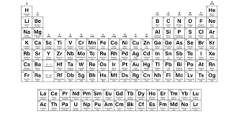
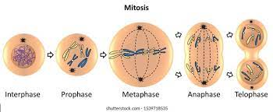
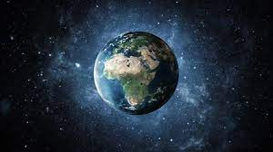
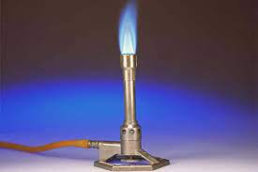
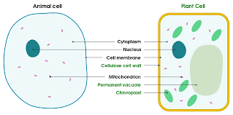
SCIENCE
Biology, Chemistry, Physics A Levels
Further study
Using resources
Chemical analysis
Move onwards
to great things!
Chemistry of the atmosphere
6 x GCSE
EXAMS
Exam skills, revision
Booster sessions
MOCK
EXAMS 3
EM waves
Electromagnets
Evolution
Forces
Organic chemistry
Waves
Ecology
YEAR
MOCK
EXAMS 2
MOCK
EXAMS 1
11
Quantitative chemistry
Chemical analysis
Genetics and reproduction
Energy changes
Chemical changes
Infection and response
Radioactivity
YEAR
10
Electrolysis
Bioenergetics
Energy
Organisation 2
Electricity
Atomic Structure
Molecules and matter
Radioactivity
Structure and bonding
The periodic table
Organisation 1
Cell Biology
Pressure
Genetics
Magnetism
Respiration and photosynthesis
YEAR
9
Environmental chemistry
Earth systems
Energetics
Space
Health
Movement
YEAR
8
Simple circuits
Itch
Pure and impure substances
Life diversity
Reproduction
Energy stores
Particle model
Waves
YEAR
Chemical reactions
7
Elements and compounds
Contact Forces
Cells

