Slide 1
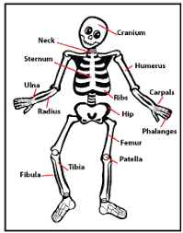
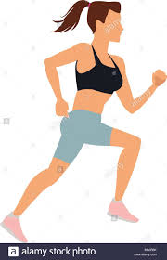
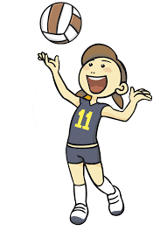
ROAD MAP OF
THE PE CURRICULUM
GCSE and CN PE
GCSE PE - Examinations x2
Cambridge National- 1 exam
GCSE PE
Practical
Moderation
PE INTENT
Year 10 -11
’to develop lifelong participation of physical activity, sport and exercise’
Year 7, 8, 9
‘’Develop skills, techniques and tactics in a variety of activities‘’
Chose core PE pathway
GCSE PE
Socio-Cultural Influences, Engagement patterns
GCSE PE
Commercialisation
11
Cambridge National R184 Contemporary issues exam
GCSE PE
Sports Psychology
Take part
In my final
Sports Day
GCSE PE
Anatomy & Physiology
Cambridge National R186 Sport and the media
Chose core PE pathway
10
GCSE PE
Movement Analysis,
Training Methods
Cambridge National R185 Performance and Leadership
Start KS4 GCSE or Cambridge National
KS4 PE
Options Evening
Chose core PE pathway:
Girls games activities
Boys games activities
Aesthetic activities
Combination activities
Take part in my 3rd Sports Day
9
GCSE PE/Cambridge National Sport Studies Taster Sessions
Participate in more new sports
Develop leadership skills in PE
Join a new sports club
Take part
in my 2nd
Sports Day
8
Participate in a range of new activities
Develop the skills, techniques and tactics of year 7 sports
7
Develop skills in a variety of sports: Football, Netball, Rugby, Badminton, Orienteering, HRF, Gymnastics, Cricket, Athletics, Rounders
Represent
a school
team
Get my PE kit
Take part in my 1st Sports Day
Attend my 1st PE lesson & meet the staff
Join an extra-curricular club
Participate in a range of new activities

