Slide 1
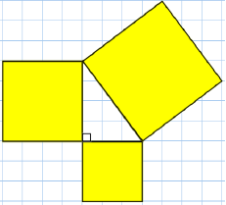
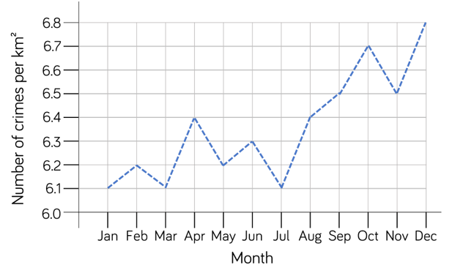
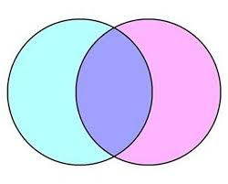
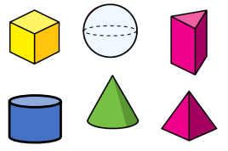
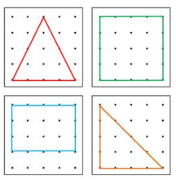
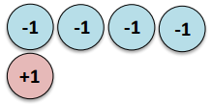
Move onwards
to great things!
Mathematics 2024/2025
A Level Mathematics
Core Maths
3x GCSE
EXAMS AQA
Exam skills, revision
Booster sessions
MOCK
EXAMS 3
Sequences
Indices
Surds
Gradients and lines
Non linear graphs
Using graphs
REVISION
Delving into data
YEAR
MOCK
EXAMS 2
MOCK
EXAMS 1
11
Further probability and combinatorics
Circles
Linear and quadratic equations
Similarity
Trigonometry
Expanding and factorising
Changing the subject
Functions
YEAR
10
Probability
Venn diagrams
Constructing with 2D and 3D
shapes
Money matters
Further angles and transformations
Pythagoras
Surds
Coordinate geometry
The data handling cycle
Measures of location
Multiplying and dividing fractions
Fractions and percentages
YEAR
9
Brackets
Equations
Inequalities
Sequences
Angles in polygons
Area and circumference of circles
Symmetry and reflection
Developing number sense
Sets and probability
Prime numbers and proof
Ratio
Multiplicative change
YEAR
Constructing and measuring
Developing geometric reasoning
8
The Cartesian plane
Scatter graphs
Sample spaces
Addition and subtraction
Multiplication and division
Sequences
Algebraic notation
Equality and equivalence
YEAR
7
Directed number
Fractional thinking
Place value and ordering
FDP equivalents

