Slide 1
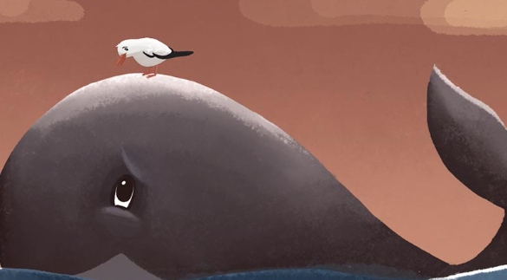
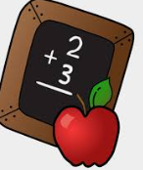
Move onwards
to great things!
German
A Level
Further study
AQA GCSE unit 8 Future plans and passions
3 X GCSE exams
Reading
Listening
Writing
Exam skills, revision
Booster sessions
MOCK EXAMS 3 and GCSE speaking exam
AQA GCSE Unit 5 House and home
AQA GCSE unit 7 The world around us
AQA GCSE unit 6 Holidays
YEAR
MOCK
EXAMS 2
11
AQA GCSE Unit 4 Health and fitness
AQA GCSE unit 3 Family and Celebrity culture
AQA GCSE unit 1
School.
AQA GCSE unit 2 Freetime
MOCK
EXAMS #1
YEAR
10
Music. Instruments and concerts
Ambitions and future plans
Literary text – “99 Luftballon” / “Ballon “ Film
Role models. Characteristics
and tenses
Literary text – Herr Vogel und Frau Wal
My first date
Healthy lifestyle. Keeping fit,
body parts.
YEAR
Media – TV, films,
reading and opinions
9
Literary text – Henry Huehnchen
Places in town / buying items
School subjects and opinions
YEAR
8
Holidays and travel
Phonics and introductions
YEAR
7
Family and Friends
A visit to the Zoo!
Hobbies and interests

