Slide 1
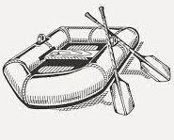
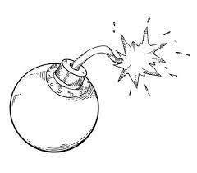
English
A Level Courses
LEES BROOK ENGLISH
Further study
GCSE Literature and Language Exam Preparation and Revision
GCSE Spoken Language Study
GCSE English Literature Paper 1 and 2
GCSE English Language Paper 1 and 2
GCSE Language: Paper 2: Writer’s Viewpoints and Perspectives
GCSE Literature: Paper 2: Power and Conflict Poetry Anthology
GCSE Literature: Paper 1: 19th Century Novel:
A Christmas Carol
YEAR
11
GCSE Language: Paper 1: Explorations in Creative Reading and Writing
GCSE Language: Paper 2: Writer’s Viewpoints and Perspectives
GCSE Literature: Paper 2: An Inspector Calls
GCSE Language: Paper 1: Explorations in Creative Reading and Writing
YEAR
10
Poetry: War and Tragic Protagonist
GCSE Literature: Paper 1: Shakespeare Play: Macbeth
Social Justice: The Victorian Gothic Genre
Shakespeare Play Study: Richard III
Class Novel Study: The Crossing
Poetry: Developing Throughout Time
Year 8: Reading and Writing for Pleasure
Class Novel Study: Animal Farm
YEAR
Introduction to Film Studies
9
Poetry: Founding Principles
The Art of Rhetoric
Shakespeare Play Study: A Midsummer Night’s Dream
YEAR
8
Class Novel Study: Asha and The Spirit Bird
Shakespeare Play Study: Romeo and Juliet
Shakespeare Play Study: A Midsummer Night’s Dream
Narrative Origins: Myths and Legends
YEAR
7
Year 7: Reading and Writing for Pleasure
Class Novel Study: Asha and The Spirit Bird

