Slide 1
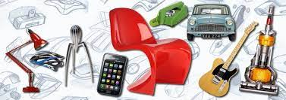
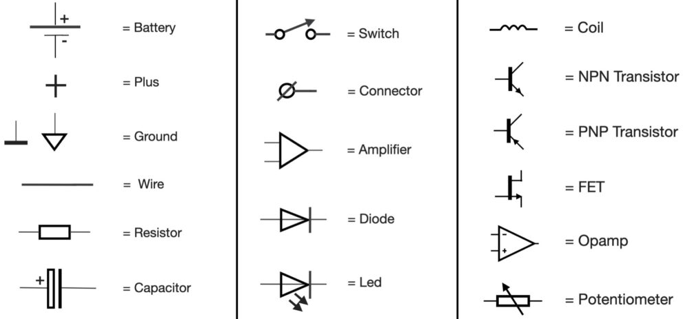
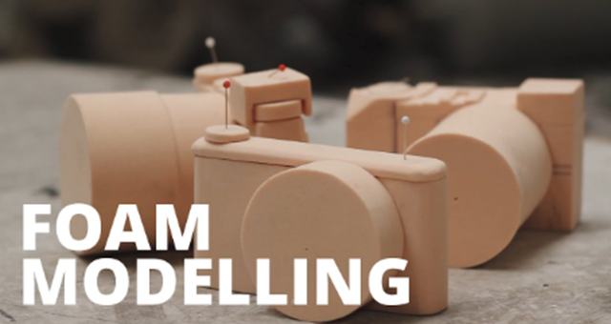
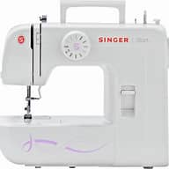
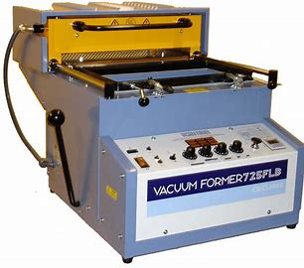
Architect
Sound engineer
Graphic designer
Interior designer
Industrial designer
Video game designer
Art director
Web developer
Civil engineer
Mechanical Engineer
Robotics Engineer
Systems Engineer
Aeronautical Engineer
Software Developer
D&T: Product Design
A Career in Design and Technology
Apprenticeships
And College
GCSE Design and Technology Exam
50%
Exam skills, revision
Booster sessions
NEA Submission
Start of NEA
50% marks
NEA Designing
And Modelling
NEA Making
And
Evaluating
Electronic Systems
MOCK
EXAMS 1
YEAR
MOCK
EXAMS 2
11
Timbers, Metals,
Polymers and Textiles
Common Specialist principles
NEA Research
AQA GCSE
Design and Technology
Energy Production and Storage
Materials and Emerging Technologies
YEAR
10
Prototype making skills
Advanced Materials: Smart Materials
Advanced Materials: Modern Materials
Idea generation skills
Practical Processes
Design development Modelling
Analysing a Brief
Advanced 3D CAD skills
Work of others (Design movements)
YEAR
9

