Slide 1
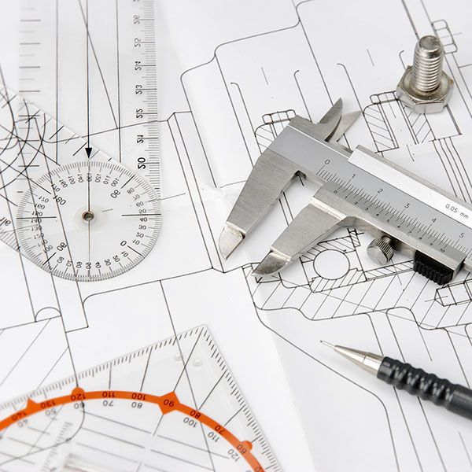
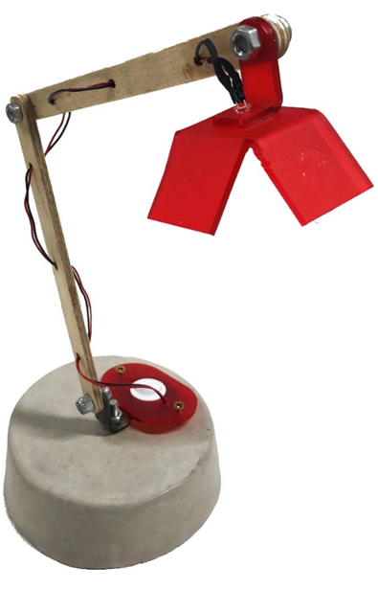
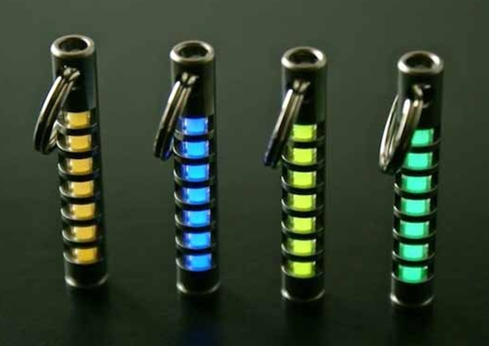
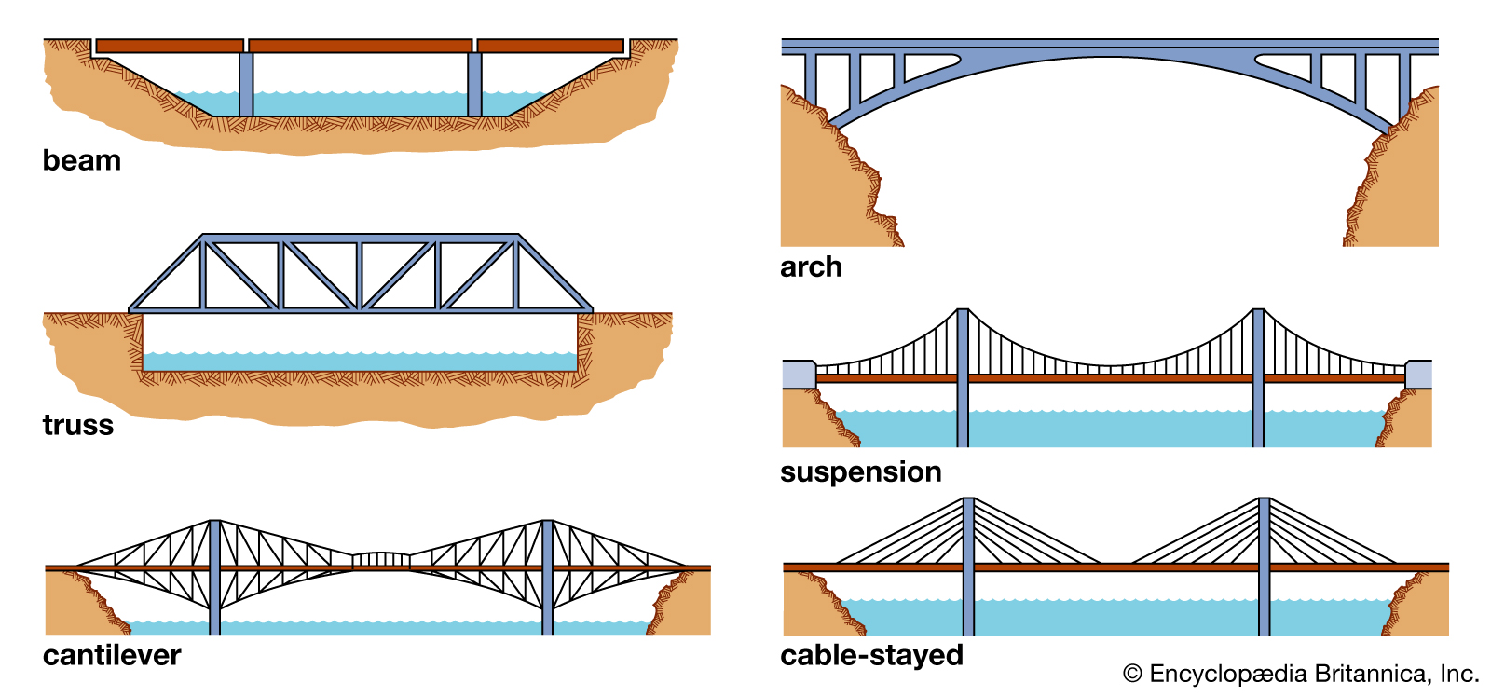
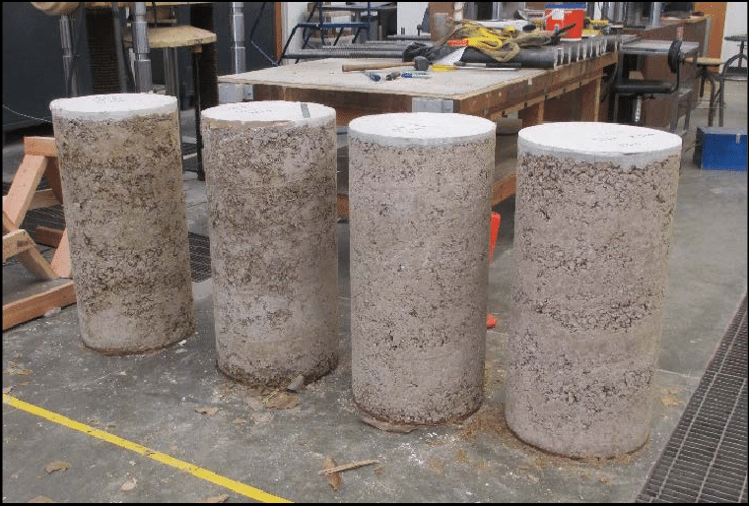
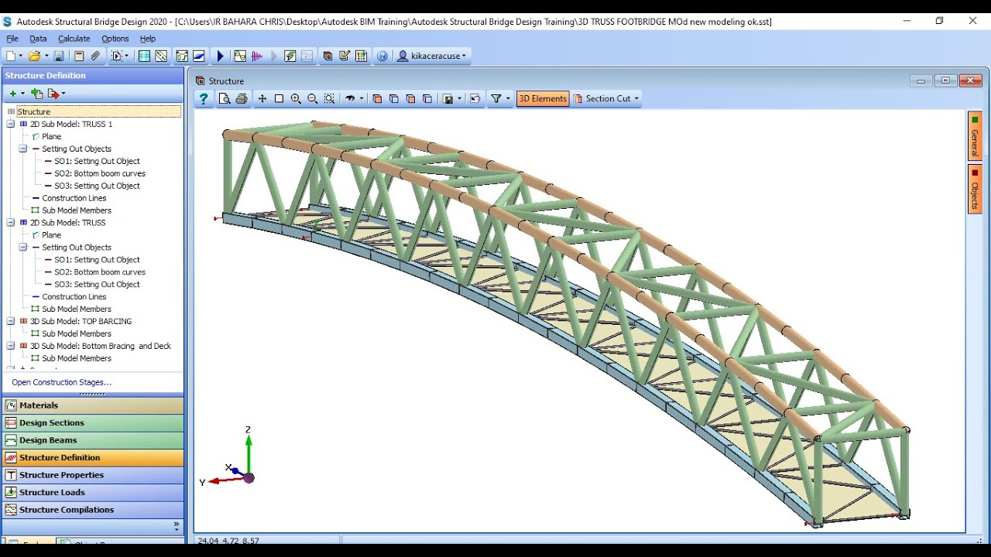
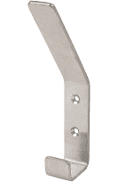
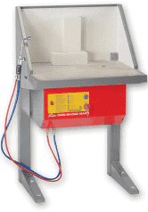
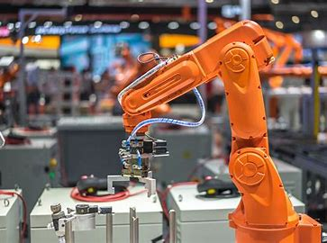
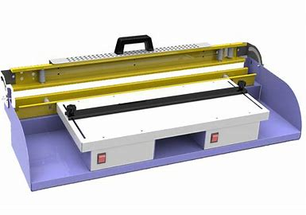
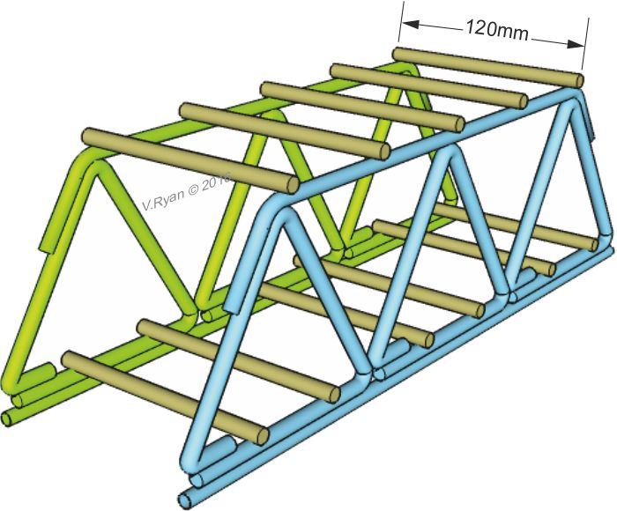
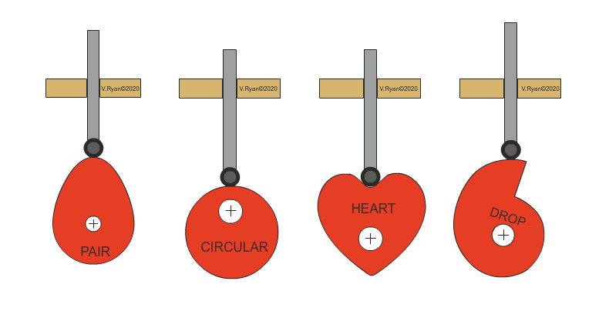
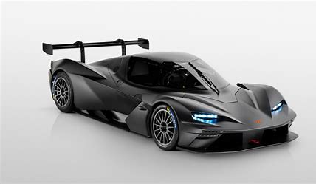
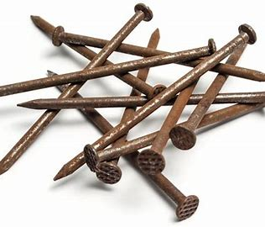
Electrical Engineer
Biomedical Engineer
Communications Engineer
Sound engineer
Civil engineer
Mechanical Engineer
Robotics Engineer
Systems Engineer
Aeronautical Engineer
Manufacturing
Product Design Engineer
D&T: Engineering
A Career in Engineering
Apprenticeships
And P16
Analysis of Brief
Research
Testing
Exam
Study support sessions
Tools, Equipment & Machines
Engineering Drawings
Making
3D CAD Skills
Synoptic project
Practical skills
Start Synoptic Project
YEAR
11
Reading engineering Drawings
Preparation for Synoptic
NCFE Level 1 / 2 Technical Award in Engineering
Properties & Characteristics of Materials
Application of Science & Maths
Engineering Disciplines
YEAR
10
Heat treatment process
Materials, properties & characteristics
Bridge model making
Quality control & Testing - gauges
Engineering Brief
Bending metals
Bridge project
Coat hook project
Engineering research skills
Engineering Structures
Design skills
Technical drawing
Robotics
New & emerging Technologies
Specialist processes
YEAR
9
In Y9 you complete 2, 5-week rotations of Engineering
CAMS
Developing practical skills
Composites
Material properties & characteristics
Systems – input, process, output
Perspective drawing
Design Approaches
Electronics
YEAR
8
Introduction Weeks
Design Engineering
User Centred Design
Design Innovation
User profiles
Intro to practical skills
Social issues
Advanced CAD
You will rotate around 3 areas of D&T in Y7 & Y8 The skills you learn here will be used in the other areas too!
H&S / PPE
Mechanisms (levers & linkages)
Source & categories of materials
3D Printing
Research skills
Product Analysis
What is D&T? Careers
YEAR
Design Engineering
Introduction Weeks
7
Laser Cutting
Design Innovation
Introduction to CAD
New & Emerging Technologies
Work of others
Isometric Drawing
Sustainable Design

