Slide 1
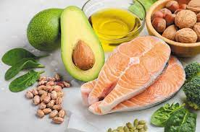
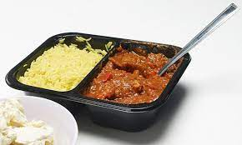
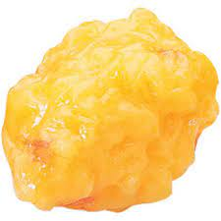
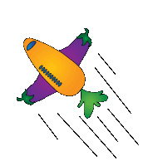
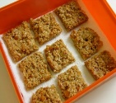
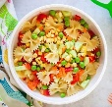
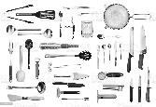
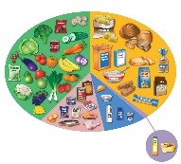
D&T: Food and Nutrition
Catering & Hospitality/ Apprenticeships
Nutritionist
Food developer
1x written exam
1hr 45mins
Exam skills, revision
Booster sessions
MOCK
EXAMS #3
NEA2 – Practical Exam
5. Food Provenance
6. Food Science/mock NEA1
Mock NEA2
NEA1 – Food Science investigation
During year 10, you will make a wide range of sweet and savoury dishes increasing in complexity
NEA2 – Food Preparation investigation
MOCK
EXAMS #1
YEAR
MOCK
EXAMS #2
11
2. Nutritional needs, diet and health
In KS4 you will study AQA Food Preparation and Nutrition
4. Food Choice
3. Food safety
1. Nutrition
YEAR
10
In year 9, you will make a repertoire of savoury dishes
Why do we need fat?
Why do we love ready meals?
Nutritional analysis
What is obesity?
Generating design ideas and annotating in detail
Why do we eat takeaways?
Do we need salt?
What is diabetes?
Food labelling and the law
Review, reflect and action plan
Generating design ideas and annotating in detail
Nutritional needs at different ages
YEAR
In Y9 you will complete 2, 5 week rotations of Food.
9
Nutrients in detail
Food and the environment
Thai Green curry
In Year 8 learners will develop confidence of cooking a range of dishes
Generating design ideas
Review, reflect and action plan
Food and Temperature
Food poisoning
Recap food safety
Ragu pasta & Macaroni cheese
YEAR
Fruity Flapjacks
8
Micronutrients
Why is food safety important?
In Year 7 learners will
develop basic understanding of nutrition and culinary skills.
Macronutrients
Pasta Salad
Health and Safety within the kitchen and food.
Equipment and their uses
Knife skills
YEAR
7
What is the Eatwell guide?
The ‘4’ C’s
Bacteria and Hygiene
You will rotate around 3 areas of D&T in Y7 & Y8 The skills you learn here will be used in the other areas too!
Pizza toast
Cooking terms

