Slide 1
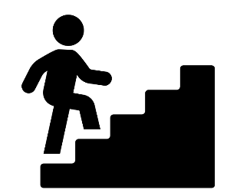
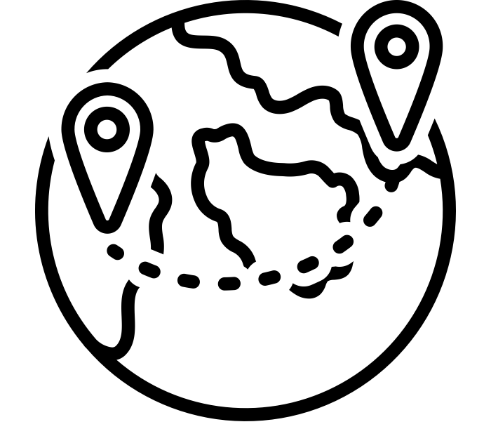
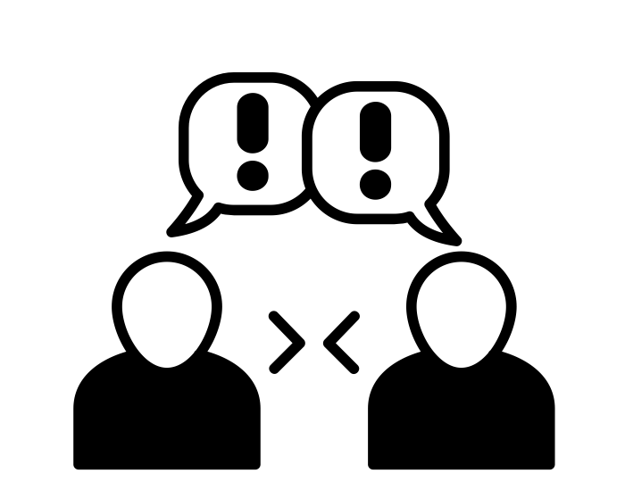
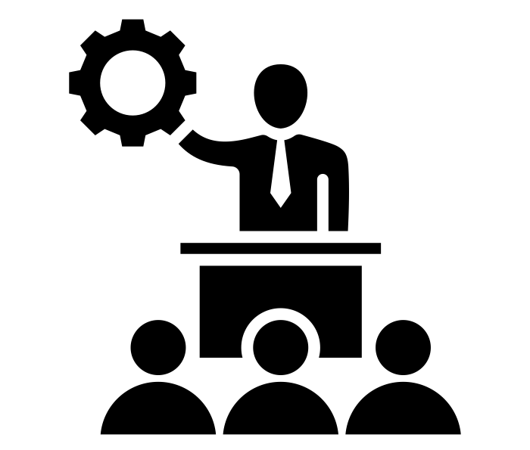
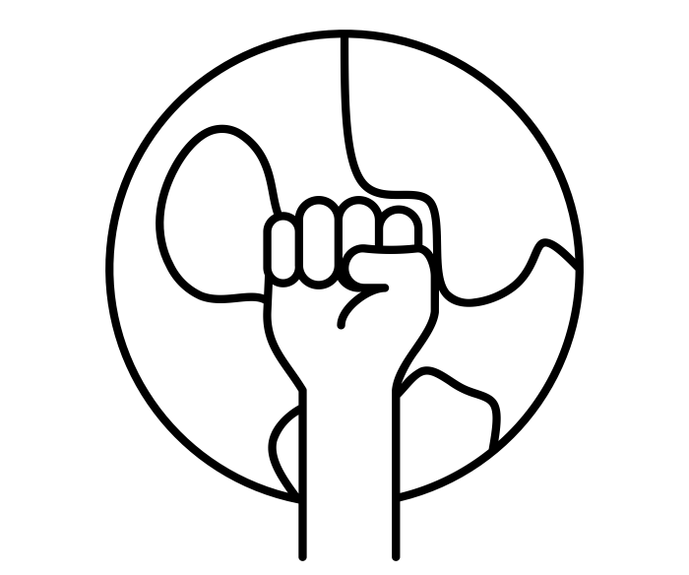
Move onwards
to great things!
HISTORY
History
A Level
Life in Elizabethan England
Including Historic environment
Further study
2x GCSE
RE EXAMS
MOCK
EXAMS 3
Exam skills, revision
Booster sessions
Migration, Empires and People – Looking West
Migration, Empires and People – Expansion and Empire
Elizabethan England: Troubles at Home and Abroad
Migration, Empires and People – Conquered and conquerors
MOCK
EXAMS 1
YEAR
MOCK
EXAMS 2
Elizabethan England: Government
11
Germany, Democracy to Dictatorship: Life under the Nazis
Germany, Democracy to Dictatorship: Weimar Germany
Conflict and Tension: Ending the First World War
Migration, Empires and People – Britain in the 20th century
YEAR
10
Germany, Democracy to Dictatorship: Rise of the Nazis
Conflict and Tension: Weapons and Tactics in the First World War
How much did the civil rights movement of the 20th century achieve?
Conflict and Tension: Causes of the First World War
A changing world: Terrorism
What do sources tell us about tensions during the Cold War?
What was the turning point of WWII?
Should the ‘forgotten’ be written into a school’s History of the First World War?
How close did Britain come to true democracy?
YEAR
9
What do sources reveal about the nature of the Holocaust?
How far were Obas the driving force behind Benin’s rise?
Did everyone benefit from the industrial revolution?
Were the Mughals the Indian Tudors?
YEAR
8
How did slavery develop and decline in the British Empire?
What did it mean to be English in the 17th century?
How have invasions changed England?
YEAR
7
What do sources reveal about Medieval life?
Did the Normans bring a ‘truckload of trouble’?

