Slide 1
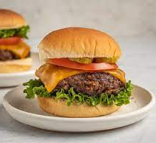
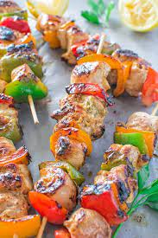
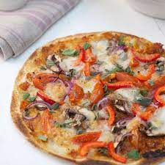
Design and Technology
Food and Nutrition – Year 9
Fakeaway project
Recipes
Homemade Burgers Sweet and Sour Flatbread Pizza Homemade Kebab

Slide 6
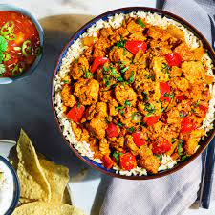
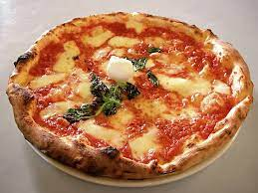
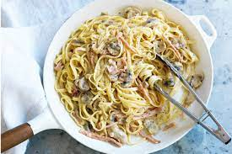
Design and Technology
Food and Nutrition – Year 9
Ready meal project
Recipes
Creamy bacon pasta Veggie Tikka Masala Real pizza Pasta Bolognaise

