Slide 1
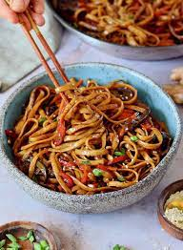
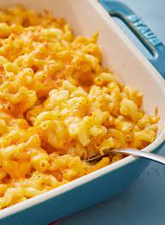
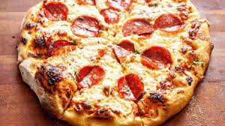
Design and Technology
Food and Nutrition – Year 8
Food for Teenagers
Recipes
Pasta Ragu Burger Cheese Straws Danish Pastries Tomato Soup Macaroni Cheese Apple Pie

