Slide 1
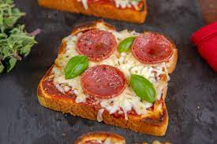
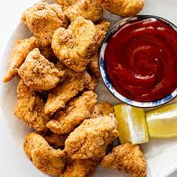
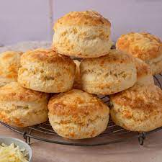
Design and Technology
Food and Nutrition – Year 7
Healthy Eating
Recipes
Pleasing pasta salad Pizza Toast Cheesy Chicken Nuggets Cheese Scones Rock Cakes Stir Fry Spring Rolls Fruit Crumble

