Slide 1

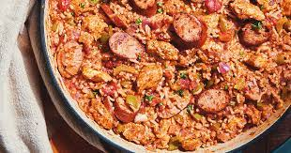
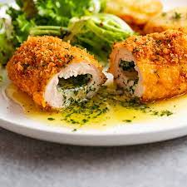
Design and Technology
Food and Nutrition – Year 10
Recipes – Term 1
Jambalaya Veggie rolls Quiche Mini Bakewell Pudding/Tarte Tatin Fruit Scones Veggie Fritatas Chicken Pie Chicken Curry & Naan Sweet Chilli Jam and cheese straws Shortbread Strudel Mince pies
Recipes – Term 1
Scotch Pancakes Dairy and gluten free Lemon Meringue pie Mayonnaise and Veg sticks Chicken Kiev Pasta Bolognaise Cottage Pie
Recipes – Term 1
Cornbread Strawberry Jam Ravioli Spring Rolls Lemon Curd Swiss roll Soda bread Fishcakes Gnocchi Chocolate Eclairs Lasagne

Slide 2
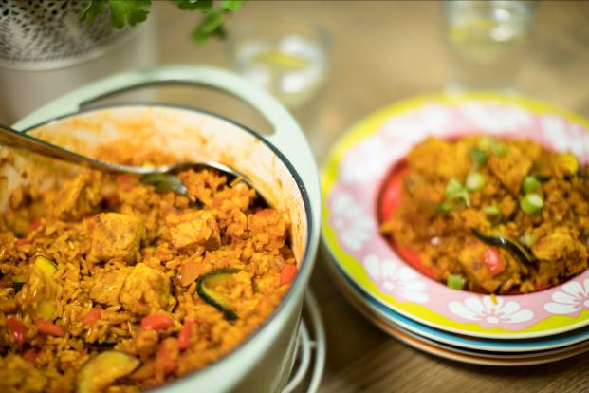
Chicken jambalaya
Ingredients
1 chicken breast or 3 Thighs
1 onion
2 garlic cloves
5 Spring onions
½ red pepper
100g button mushrooms
1 Courgette
1 x 5ml spoon mild chilli powder
2 x 5ml spoon ground turmeric
225g easy cook rice
1 stock cube
1 x 400g can chopped tomatoes
Method
Remove any visible fat from the chicken.
Cut the chicken into cubes. Thoroughly wash and dry your hands after touching the raw meat.
Prepare the remaining ingredients:
  peel and dice the onion;
  peel and crush the garlic cloves;
  slice the spring onions into circles, reserving some green tips for garnish;
  deseed and dice the red pepper;
  quarter the button mushrooms;
  halve the courgette and slice diagonally.
Spray the oil into the pan and allow to heat.
Add chicken to pan, stir and allow to brown.
Remove browned meat from the pan, and place on a clean plate.
With the pan still on the heat at the onion, garlic, chilli powder, turmeric and rice.
Stir well and cook until the rice turns opaque.
Pour 450 ml of water into saucepan and add stock cube.
Add the tomatoes.
Season with freshly ground black pepper.
Sir well and turn up the heat to boil.
Cover with a lid and simmer for 20 minutes.
Add the chicken, whole cloves, spring onions, red pepper, mushrooms and courgettes and stir well.
Cook for a further 10 minutes, or until the liquid is absorbed. Stir occasionally.
Sprinkle with the reserved green tops of the spring onions and serve.

Slide 12
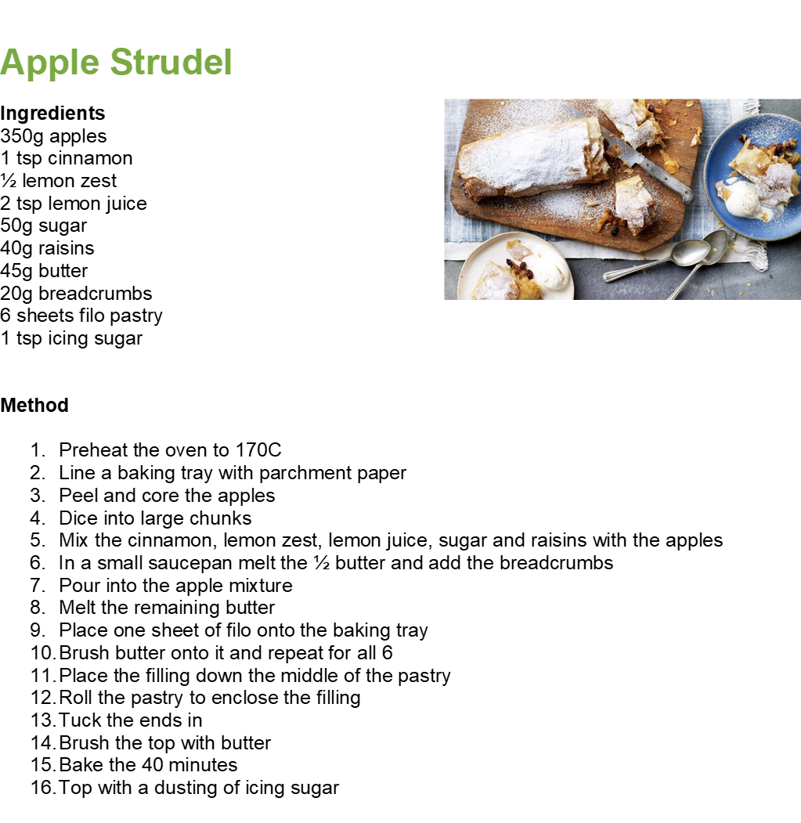

Slide 16
