Slide 1
GCSE Information Evening
November 2022

Slide 2
Year 11 – this is your year!
Rec | Yr1 | Yr2 | Yr3 | Yr4 | Yr5 | Yr6 | Yr7 | Yr8 | Yr9 | Yr10
12 years of education
1 goal
Do not give up now
This is your year

Slide 3
Year 11 Road Map
WTM (now)
Mock Exams
Mock Exam results Interview
Subject Evening/Careers Event
Strive for 5
Mock Exams #take2
Wellbeing week
WTM #take2
GCSE Exams

Slide 4
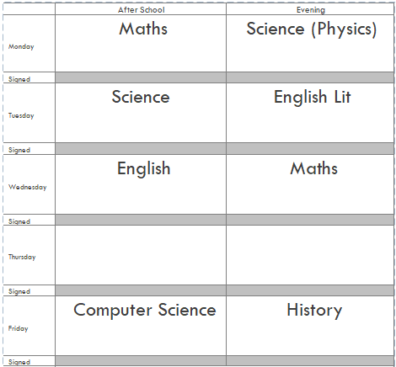
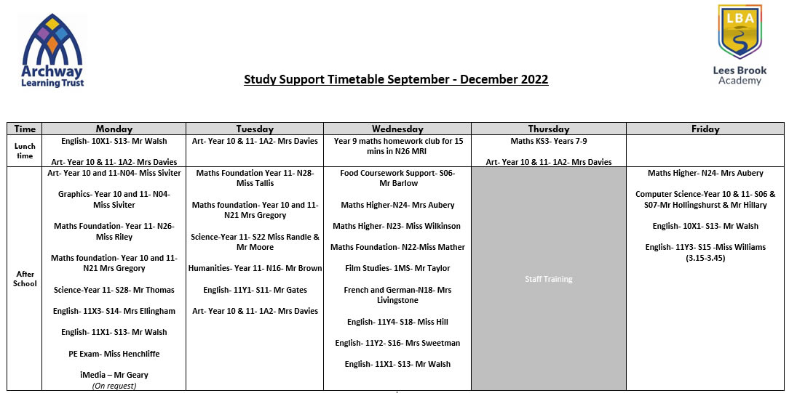
Study Support
Expected Year 11 attend
Period 6
Focused areas of support
Create a timetable?
https://www.leesbrook.co.uk/extracurricular/rhse/

Slide 5
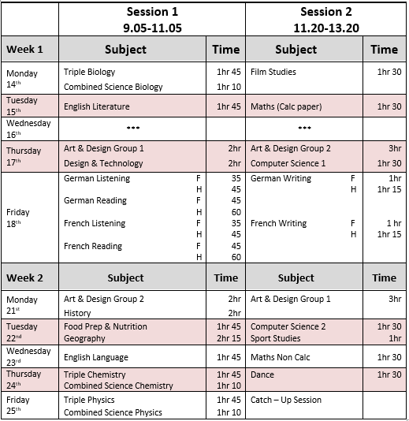
Mock Examinations
Start 14th Nov 2022
Two weeks
Results will be used for college interviews
Final GCSE Exam date: Wed 28th June 2023

Slide 6
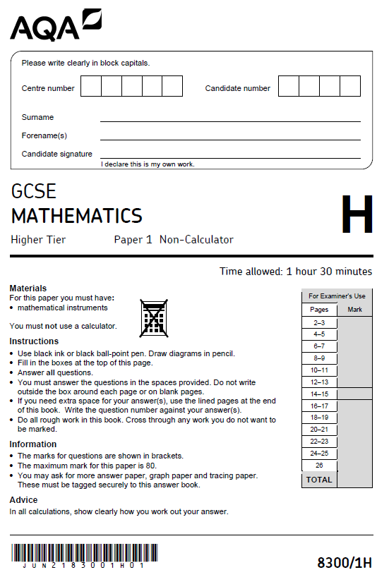
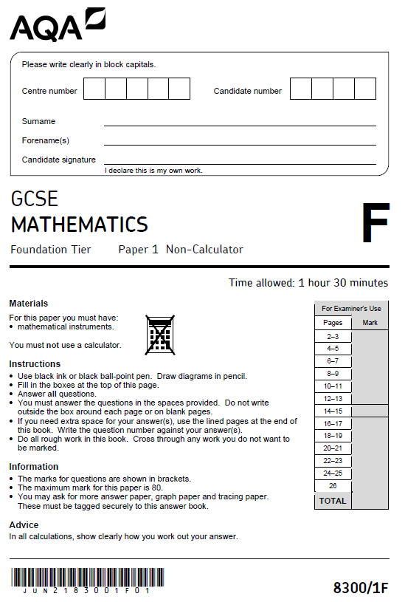
Information about GCSE Mathematics
3 exam papers that test the whole National Curriculum
Higher Tier (Grades 9-3) and Foundation Tier (Grades 5-1)
Paper 1: Non Calculator
Paper 2: Calculator
Paper 3: Calculator
Each exam is 1 hour 30 minutes long and is scored out of 80.
Students must answer all questions
Formula sheet WILL be available for 2023 summer series

Slide 7
Why is gaining your Mathematics GCSE so important?
Ability to live independently
Further study opportunities
Employment opportunities
Income
Mental health
Students must study mathematics until they are 18 unless they hold a GCSE at grade 4 or above

Slide 8
Advice and Support
Study Support
RAP sheets
Revision lists
Passports
Hegarty Maths
BBC bitesize

Slide 9
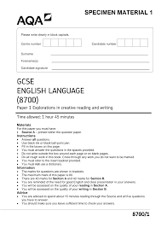
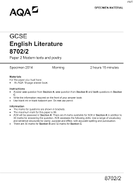
Information about GCSE English Language and GCSE English Literature
2 exam papers for English Language – both 1 hour 45 minutes
Paper 1 fiction/Paper 2 non-fiction
2 exam papers for English Literature
Paper 1 Macbeth and A Christmas Carol – 1 hour 45 minutes
Paper 2 An Inspector Calls and Poetry – 2 hours and 15 minutes
There are no tiered papers and it is 100% exam based
Students must answer all questions for English Language
Students must only answer the question for the text that they
have studied for English Literature

Slide 10
Why is gaining your English GCSE so important?
Achieving a L4/L5 (alongside Maths) opens more opportunities
Employment opportunities
Higher income
Greater independence and confidence
Ability to live and function independently
Ability to make sense of the wider world and make informed decisions

Slide 11
Advice and Support for English
Study Support
Holiday revision sessions
Intervention
RAP sheets
Free copy of the texts
Revision resources
YouTube – Mr Brough
BBC bitesize
English Literature
Students are expected to revise and memorise around 130 quotes so that they are ready for any potential exam question. Their brains WILL NOT retain this information if they decide to cram in all of their revision the day, weeks or month before the exams. They need to give their brains time to place these quotes into their long term memory and be able to recall the quotes freely.
This begins now!

Slide 12
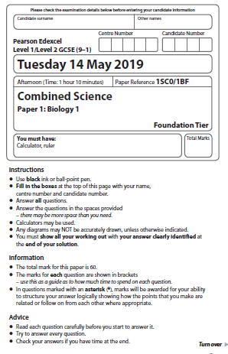
Information about GCSE Science
Six exam papers that test the whole National Curriculum
Two Biology papers
Two Chemistry papers
Two Physics papers
Higher Tier (Grades 9-4) and Foundation Tier (Grades 5-1)
Each Combined Science exam is 1 hour 10 minutes long and is scored out of 60.
Each Triple Science exam is 1 hour 45 minutes long and is scored out of 100.
Students must answer all questions
Physics formula sheet WILL be available for 2023 summer series

Slide 13
Why is gaining your Science GCSEs so important?
Combined Science counts as two GCSE grades
Triple Science counts as three GCSE grades
Able to make decisions in a scientific and technological world
Able to evaluate information in the media, including social media
Further study opportunities
Employment opportunities
Income

Slide 14
Advice and Support for Science
Study Support
RAP sheets
Revision lists
Past papers
Century Tech app
Seneca revision app
BBC Bitesize

Slide 15
Thank you.
Please now visit all subjects studied in the dining area. They will all have information you can take away to help in the preparation for the mocks and GCSE exams.

